Slide 1
PRESENTATION TITLE
LOAN DEFAULTER PREDICTION
Natwar Upadhyay
DATE : 06th September, 2023

Slide 2
TEXT LAYOUT 1
Agenda
Data Science Lifecycle​
Project Overview​
Data
Analysis
Modeling
Model Evaluation
Recommendations

Slide 3
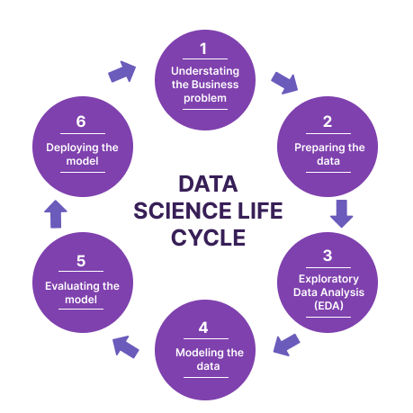
TEXT LAYOUT 1
Data Science Lifecycle
1. Problem Definition: The initial step involves gaining a comprehensive understanding of the business problem that requires resolution.
2. Data Gathering: Following the problem definition, the subsequent stage is to amass the pertinent data.
3. Data Preprocessing: After data collection, it becomes imperative to clean, transform, and preprocess the collected data.
4. Data Exploration: This phase encompasses the visualization of data and the execution of exploratory data analysis (EDA) to grasp data patterns and relationships.
5. Model Development: Once the data has been prepared and explored, the next step involves constructing a predictive model using machine learning algorithms.
6. Performance Assessment: Subsequent to model creation, an evaluation phase is crucial. This entails using appropriate metrics to gauge the model's performance, which may encompass accuracy, precision, recall, and F1 score.
7. Deployment: Following successful evaluation and validation, the model is ready for deployment in a production environment.
8. Ongoing Monitoring and Maintenance: After deployment, continuous monitoring and maintenance are essential to ensure the model's sustained performance and reliability.

Slide 4
TEXT LAYOUT 1
Project Overview
Business Problem: This issue articulates the business's apprehension regarding loan defaults and the repercussions it exerts on their financial well-being.
Business Objective: The business aims to construct a precise predictive model to detect high-risk borrowers early in the loan approval process. This objective also delineates the anticipated advantages of the project, encompassing the reduction of default rates and associated losses, enhancement of financial performance and stability, and streamlining the loan approval procedure. By fulfilling these objectives, the business can adeptly manage risk and secure enduring success.
Hypothesis: The hypothesis statement itemizes the specific variables that the project team believes will exert a substantial influence on loan defaults. By explicitly stating this hypothesis, the project team can channel their focus towards these variables during data exploration and feature engineering, ensuring that the predictive model is finely tuned to account for the most pivotal factors influencing loan defaults.

Slide 5
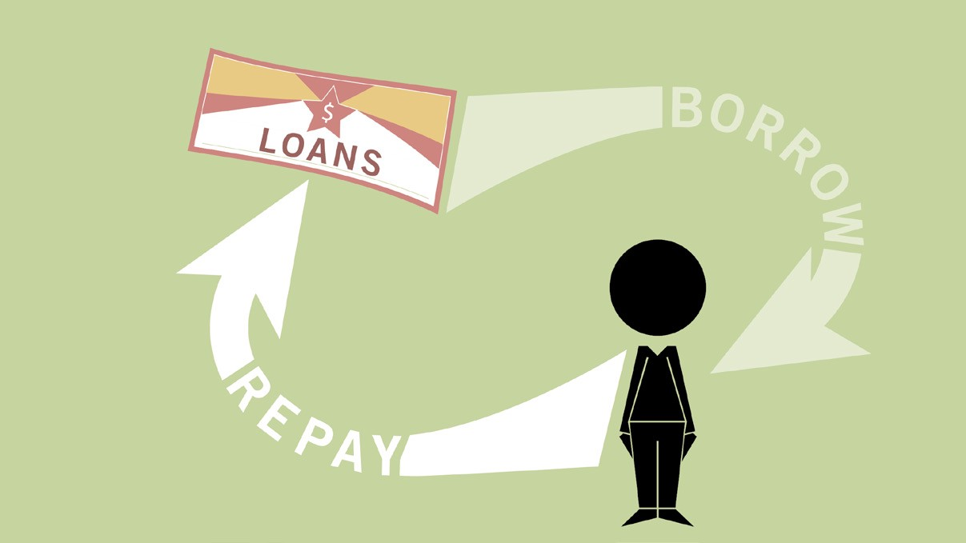
TEXT LAYOUT 1
Process Overview / Solution
1. Problem Definition and Objective Setting: Identify the business problem, project goals, and available data.
2. Data Exploration and Cleaning: Review and ensure data cleanliness by addressing missing values, outliers, and potential accuracy-affecting issues.
3. Feature Engineering: Determine crucial variables affecting loan defaults, which may involve creating new features or selecting statistically significant ones.
4. Model Selection and Building: Choose an appropriate model (e.g., logistic regression, decision trees, or random forests). Train and refine it with historical data, adjusting parameters for accuracy.
5. Model Evaluation and Refinement: Assess model performance with metrics like precision, recall, and F1 score. Enhance it through feature selection, parameter tuning, or ensemble methods.
6. Model Deployment and Monitoring: Deploy the model in production, ensuring integration and scalability. Continuously monitor and update it as new data or market conditions change.
7. Business Impact Analysis: Evaluate the model's effect on business objectives (e.g., reducing defaults, improving profitability, optimizing approvals). Use insights for ongoing refinement.
By following this process, the project team efficiently addresses the loan default prediction challenge, providing a valuable predictive model that enhances financial stability and delivers business benefits.

Slide 6
TEXT LAYOUT 1
Data
The project used data from Kaggle: https://www.kaggle.com/datasets/altruistdelhite04/loan-prediction-problem-dataset.
There are two CSV files, Train and Test. The Training dataset has 614 observations and 13 columns, while the Testing dataset has 367 observations and 12 columns.
The data comprises 981 observations and 13 variables. Eight columns (Loan_ID, Gender, Married, Dependents, Education, Self_Employed, Property_Area, Loan_Status) are categorical, and the remaining five columns (ApplicantIncome, CoapplicantIncome, LoanAmount, Loan_Amount_Term, Credit_History) are numerical.

Slide 7
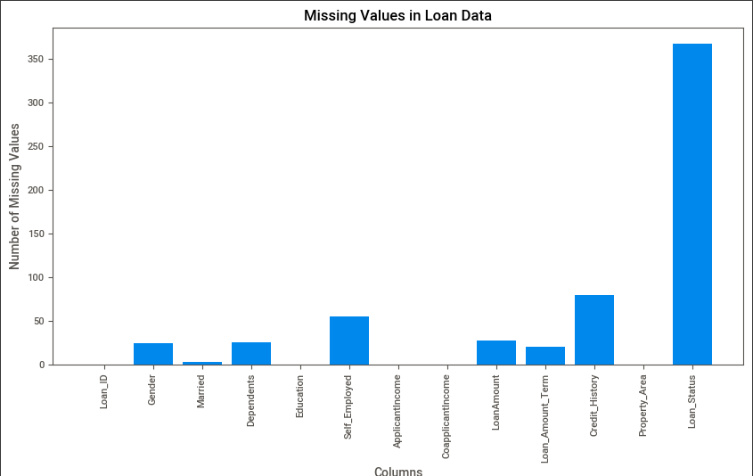
TEXT LAYOUT 1
Analysis
Missing Value Analysis:
The plot on the right-hand side provides a visual representation of the missing values within the combined Train and Test datasets.
Both the Training and Testing datasets contain numerous null values, which will be addressed prior to any machine learning tasks or processes.

Slide 8
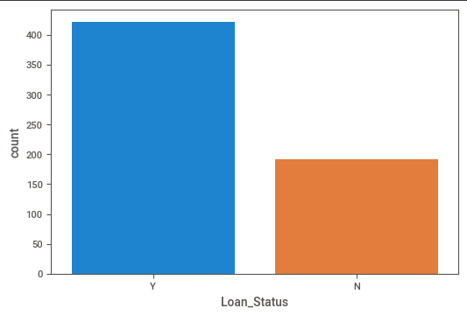
TEXT LAYOUT 1
Analysis
Loan Default Analysis:
The plot on the right-hand side visually illustrates the number of people with loan acceptance.
Based on the plot, it's evident that the 'yes' credit status in the data is predominant. If this ratio is excessively high, it could pose challenges for machine learning algorithms.

Slide 9
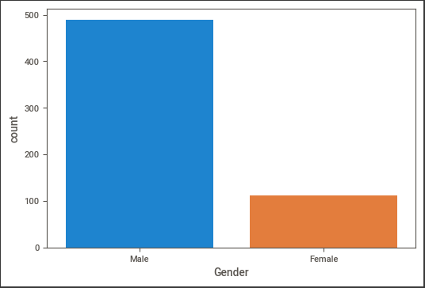
TEXT LAYOUT 1
Analysis
Gender Analysis in Relation to Loan Defaults:
The plot on the right-hand side visually compares loan defaults based on gender.
Looking at the gender value counts, it's evident that males are more prevalent among the observations.

Slide 10
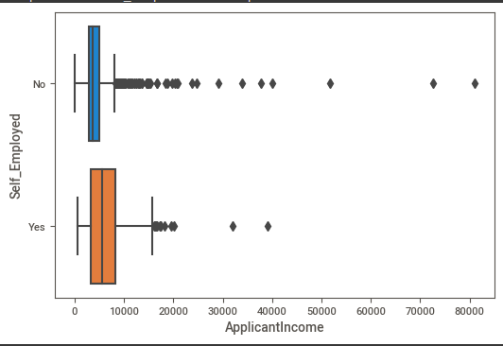
TEXT LAYOUT 1
Analysis
Income Comparison: Employed vs. Self-Employed
The plot on the right side provides a visual comparison of incomes between employed and self-employed individuals.
On average, it seems that employed individuals tend to have higher incomes. However, to establish a conclusive result, additional statistical tests will be undertaken.

Slide 11
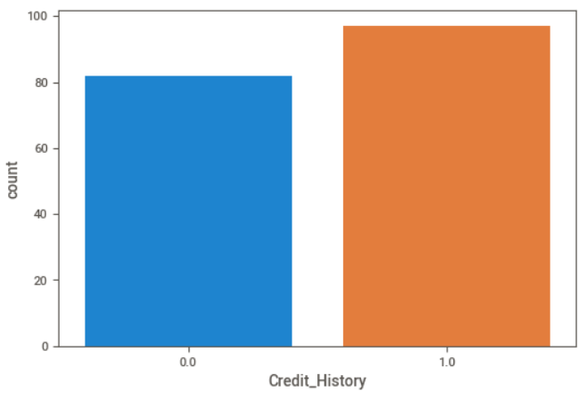
TEXT LAYOUT 1
Analysis
Analysis of Credit History's Impact on Loan Default:
The plot on the right-hand side visually compares the likelihood of default among applicants with and without a credit history.
A statistical test will be conducted to compare the default rates between those with a credit history and those without.
Initial observations suggest that applicants with a credit history have a higher default rate. Subsequently, a statistical analysis will be performed to confirm whether having a credit history increases the likelihood of default.
The results of the statistical test (p < 0.05) indicate that the likelihood of default is indeed higher for applicants with a credit history compared to those without one.

Slide 12
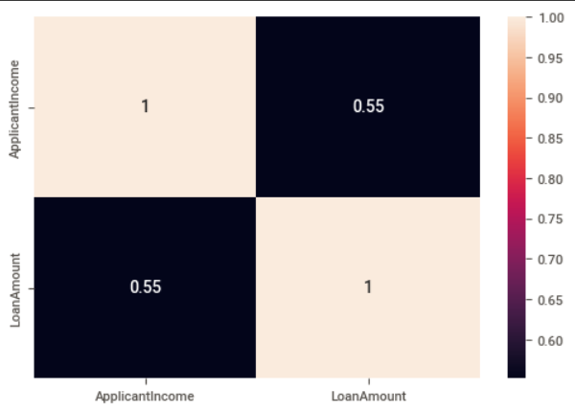
TEXT LAYOUT 1
Analysis
Analysis of the Relationship Between Applicant Income and Loan Amount:
The plot on the right-hand side visually illustrates the correlation between the applicant's income and the loan amount they requested.
The correlation coefficient of 0.55 indicates a moderate relationship between the income of the loan applicants and the loan amounts they have applied for.

Slide 13
TEXT LAYOUT 1
Modeling
Before we start modelling the machine learning model we have to remove the null values, as in analysis slide we see we have very high NAN values or Missing values.
We will Treat it with replacing the values with Median and mode.
We will do Feature selection and split the data in X , Y to train the model .
To remove the scaling problem we will use the StandardScaler to scale the data in preferable range.
We will use the K-fold Cross validations technique to get the scores for the 5 folds run we get Best Cv score has 81%.
As it is the Classification Problem we will use the Logistic regression as our algorithm for our dataset and problem.

Slide 14
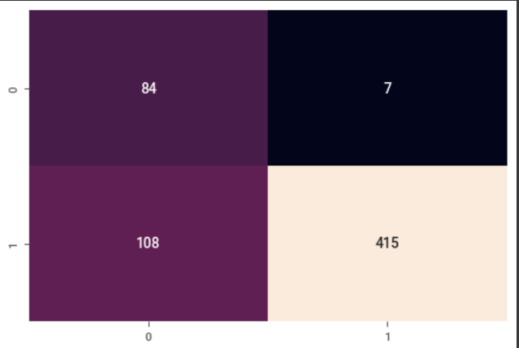
TEXT LAYOUT 1
Model Evaluation
After running cross validation and getting best model for our modelling.
We will fit our variables with best fit and best model which Logistic Regression.
After Fitting the model we get the Accuracy of 81%.
Right side is the confusion matrix for the model we run. It showing the classes probability.
With the help of the confusion matrix we got values for our classes we can calculate Precision, Recall .
Precision and Recall where Precision is 0.92 and Recall 0.43

Slide 15
TEXT LAYOUT 1
Recommendations
For Future Recommendations to Address or Prevent the Problem Statement:
1. Feature Engineering: Continue to explore and enhance the features used in the model. Consider introducing new variables, such as borrower credit scores or payment history, that could enhance loan default predictions.
2. Data Quality Assurance: Ensure that the data used for model training and testing remains accurate, complete, and up-to-date. Implement a routine data quality assessment process to promptly rectify any data issues.
3. Business Impact Assessment: Consistently assess the business impact of the model and make necessary adjustments to align with organizational goals. Develop a systematic reporting mechanism to keep stakeholders informed about the model's performance and influence.
4. Regulatory Compliance: Guarantee that the model adheres to all relevant regulations and guidelines, including fair lending laws and data privacy regulations. Establish a regular review and update process to maintain ongoing compliance.
5. Collaborative Approach: Explore opportunities for collaboration with other departments or external partners to access additional data sources and expertise. This collaborative approach can enhance model accuracy and effectiveness while fostering a culture of teamwork within the organization.

Slide 16
THANK YOU

